Slide 1
Overview of the contents of the Thesis

Slide 2
Chapter 1- Problem and Its Background
Introduction
Background of the Study
Theoretical Framework
Conceptual Framework
Conceptual Framework of the System
Conceptual Framework of the Study
Statement of the Problem
Hypothesis
Significance of the Study
Scope and Limitation
Scope and Limitation of the System
Scope and Limitation of the Study
Definition of Terms

Slide 3
Chapter 2: Review of Related Literatures
2.1 Related Literatures
2.2 Related Studies
2.3 Synthesis of the Study

Slide 4
Chapter 3: Research Methodology
3.1 Research Methodology
3.2 Research Design
3.3 System Architecture
3.4 Software Development Paradigm
3.5 Population Frame and Sample Size
3.6 Description of the Respondents
3.7 Sampling Technique
3.8 Instrumentation
3.9 Data Gathering Procedure
3.10 Statistical Treatment of Data

Slide 5
Chapter 4: Presentation, Analysis and Interpretation of Data

Slide 6
Chapter 5: Summary of findings, Conclusion and Recommendations
5.1 Summary of Findings
5.2 Conclusions
5.3 Recommendations

Slide 7
References Appendices

Slide 8
Chapter 1 The Problem and Its Background

Slide 9
Chapter 1: The Problem and Its Background
Introduction
Background of the Study
Theoretical Framework
Conceptual Framework
Statement of the Problem / Objectives

Slide 10
Chapter 1: The Problem and Its Background
Continuation…..
Hypothesis/ses
Assumptions
Significance of the Study
Scope and Limitations of the Study
Definition of Terms

Slide 11
Introduction
Narrative explanation of the problem by presenting the big picture and narrowing it to the problem itself
2 main purposes:
Give overview of main points of your thesis
Awaken the reader’s interest
Introduce the topic and the problem statement
Describe how your thesis is constructed
Cite previous research in the area
Cite who had the idea or ideas first, who has done most recent and relevant work
Explain why more work was necessary (pertains to your work)

Slide 12
Introduction: what it contains
State goal of paper: why study was undertaken
Provide sufficient background to understand context and significance of question trying to address
Acknowledge previous work on which you are building, provide sufficient references for clarity
Cited works should be relevant to the thesis
Explain scope of work, what will and will not be included
A verbal road map of what lies ahead
Emphasize where introductory material ends and your contribution begins

Slide 13
Background of the Study
Presented as either historical or contextual.
Historical background presents facts, issues, and other information from the past up to the present situation related to the problem of study
Contextual background presents issues surrounding the topic under study
Review relevant research / literature to demonstrate need of research

Slide 14
Theoretical Framework
Presents theories which are related to the problem of study (backed by literature review)
Identify key concepts, evaluate relevant concepts, theories and models
Compare different reviews read and choose the best that fits your research and justify why this is the case
Indicate notable links between concepts
Aside from describing relevant theories and models, argue why you are not applying it to your research

Slide 15
Theoretical Framework (checklist)
Key concepts mentioned in research question and hypotheses
Theories and models relating to research analyzed
Hypotheses has been justified based on models and theories
Notable relationships between concepts are explained
Descriptive research questions have been answered
Theoretical framework has a logical structure
Relevant and recent sources have been consulted
Sources are cited in the right way

Slide 16
Literature Review (Chapter 2 ) *Has a bearing in the theoretical framework
Describe what discussions on the study exist within the literature
Explain methods, theories, and models other authors have applied. Argue why a particular theory or model is or is not appropriate for your research
Analyze similarities and differences between your research and earlier studies
Explain how your study adds to knowledge that already exists on the subject
This study may find answers to the following questions:
Did anybody else formulate the same research problem in the past?
Did anybody else solve the same or similar problem in the past?
Are the results of the previous solving acceptable for us or not?

Slide 17
Conceptual Framework
Presents researchers own view of his study through a diagram
One example is the IPO model

Slide 18
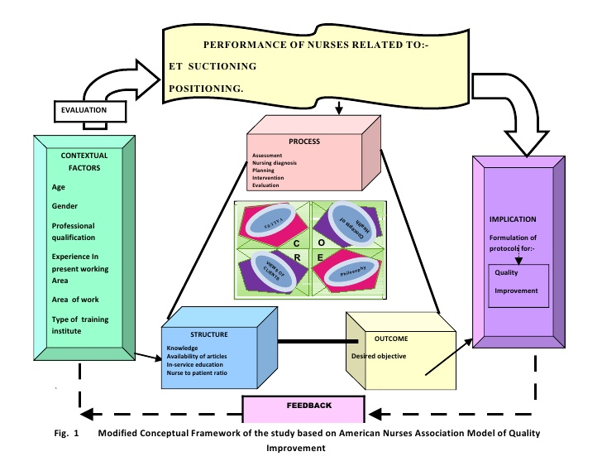
Conceptual Framework

Slide 19
Statement of the Problem / Objectives
Be sure that what is stated / declared can be answered.
Objectives – stated in declarative form
Statement of the problem – stated in question form
Defines what the researcher wants to achieve / answer
The statements stated are what is to be answered and discussed in Chapters 4 and 5.
Objective: To identify the student assessment on the ____ in terms of : accuracy, user friendliness, completeness ….
Statement of the problem: What is the assessment of the students on the _____ in terms of accuracy, user friendliness,….?

Slide 20
Process Scheduler Tool kit (Prochek): An assessment
The study aims to answer the following questions:
What is the degree of accuracy using user created problems in terms of:
a. Gantt Chart
b. Turn-around time
c. Waiting time
2. What is student’s assessment of Prochek in terms of:
a. User-Friendliness
b. Functionality
c. Reliability
d. usability

Slide 21
Hypothesis/ses
Researcher poses intelligent speculations about the variables of the study.
Example: There is no significant difference between the developed system using ____ algorithm and the system using ___ algorithm.
Either the researcher rejects or accepts the hypothesis at the end of the study

Slide 22
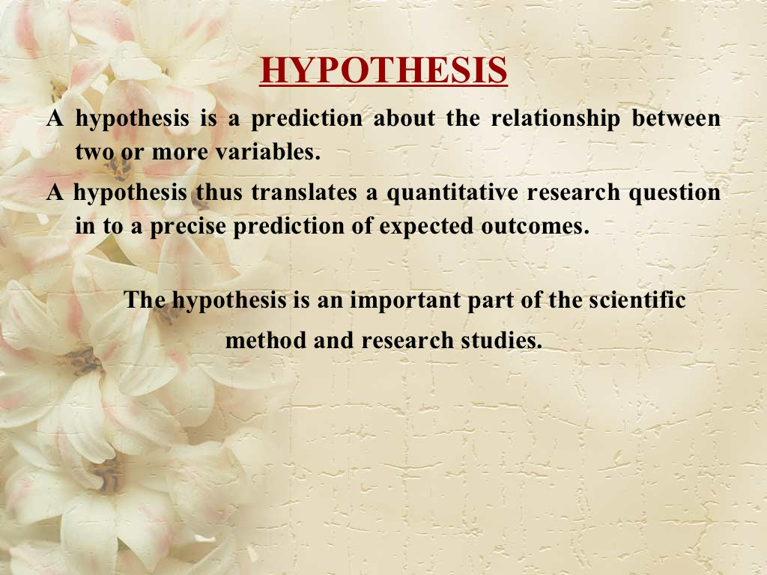

Slide 23
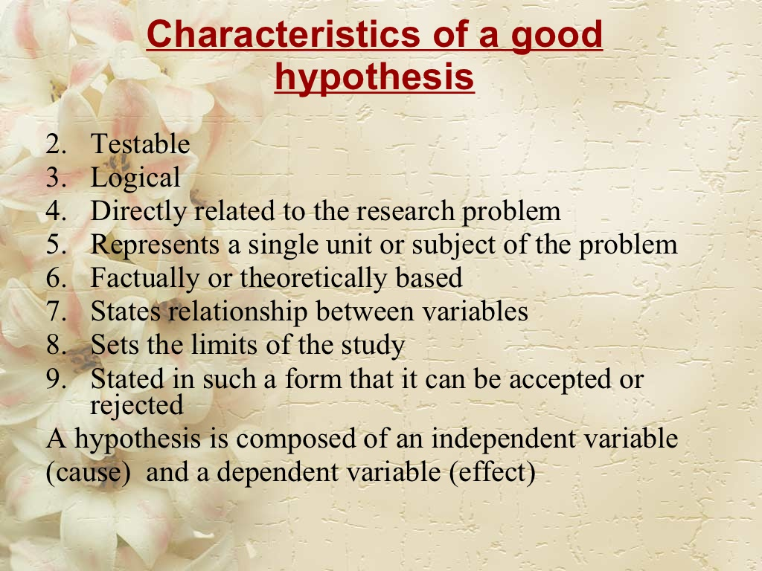

Slide 24
Assumptions
Optional part of most theses, presents facts normally taken for granted in the study
Sets the atmosphere where the study will be conducted

Slide 25
Significance of the Study
Presents value of the proposed study
Identifies beneficiaries of the study upon completion
Do not confuse the study and the software to be developed.
The development of the software may be one of the objects of the study.
The study refers to the problems stated to be solved

Slide 26
Scope and Limitation of the Study
Scope -State coverage of the study, includes
individuals who will participate in the study
Locale where study is undertaken
Period when study is to be conducted
Topic or content of the study
Limitation – state conditions beyond the study

Slide 27
Definition of Terms
Defined either conceptually or operationally
Conceptual definition – coming from dictionaries, encyclopedia
Operational definition – coming from the words of the researcher
Include terms frequently used throughout the study
Best to include terms found in the Title and statement of the problem
Technical terms must be defined conceptually
Ambiguous terms must be defined operationally

Slide 28
Introduction /Background/Context/Review of literature
The subject of the research is important because…
Those who have worked on this subject include…
What has not yet been done is…
The research project aimed to…
From Murray, R. (2002) How to write a thesis, pp. 215-216. Maidenhead: Open University Press.

Slide 29
Theory/Approach/ Method /Materials/Subjects
This study was based on the approach of…
This approach was chosen because…
It was likely to achieve the project aims by…
Others have used this method to…
From Murray, R. (2002) How to write a thesis, pp. 215-216. Maidenhead: Open University Press.

